Slide 1


Slide 2
Why do I Need GIT ?
Makes it way easier to Undo Errors/ Roll Back to earlier version of code.
Share a code between developers without creating conflicts.
Deploy changes from development to production environments.
Revert files to previous state.
Revert entire project back to previous sate.
Compare changes over the time.

Slide 3



Popular Version Control Systems
CVS - Concurrent Version System
SVN - SubVersioN
Git
Mercurial
Bazaar
LibreSource
BIT Bucket

Slide 4

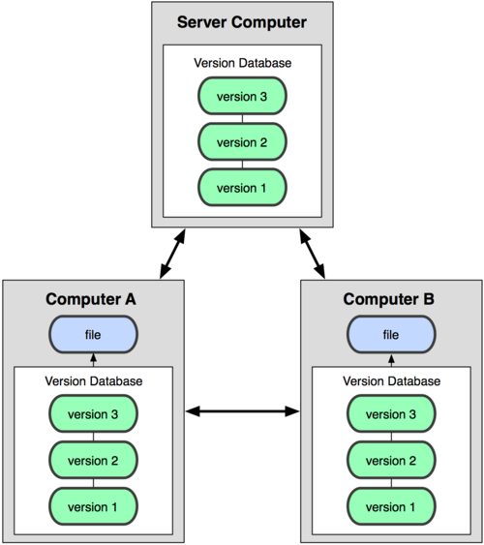
Why it is Easier ?
Centralized Model
Distributed Model
(CVS, Subversion)
(Git, BIT Bucket)
Result: Many operations are local

Slide 5
Distributed Model
Every Git working directory contains the complete repository and history and full revision tracking capabilities.
You’re not dependent on a central server and you don’t have to be online.
It’s extremely fast - much faster than SVN, CVS and other systems.

Slide 6
Git - Use Cases
Individual Development.
Collaborative Development.
Oﬁline Usage.

Slide 7
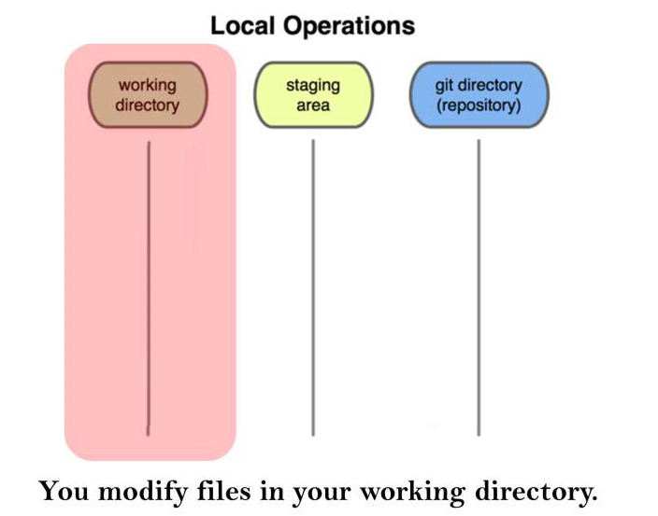
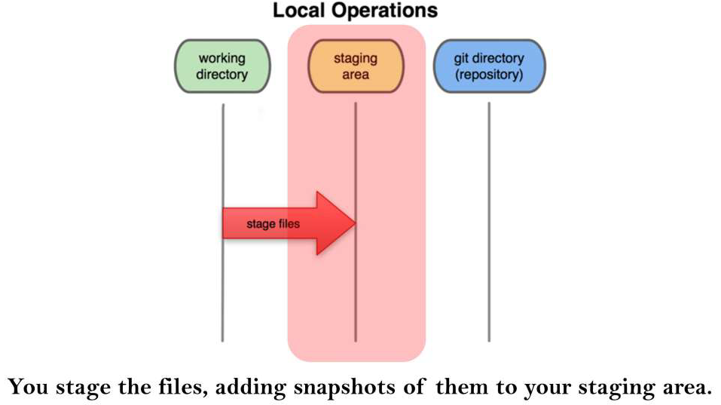
Git Work Flow 3 Stages

Slide 8
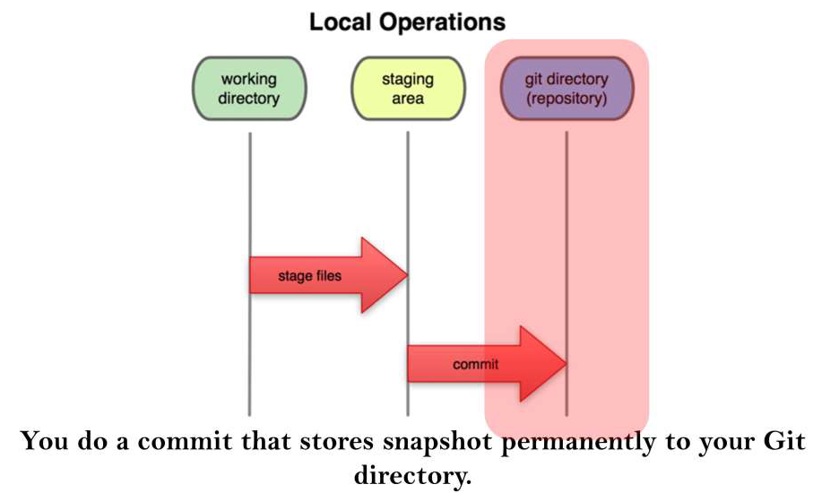
Git Work Flow 3 Stages

Slide 9
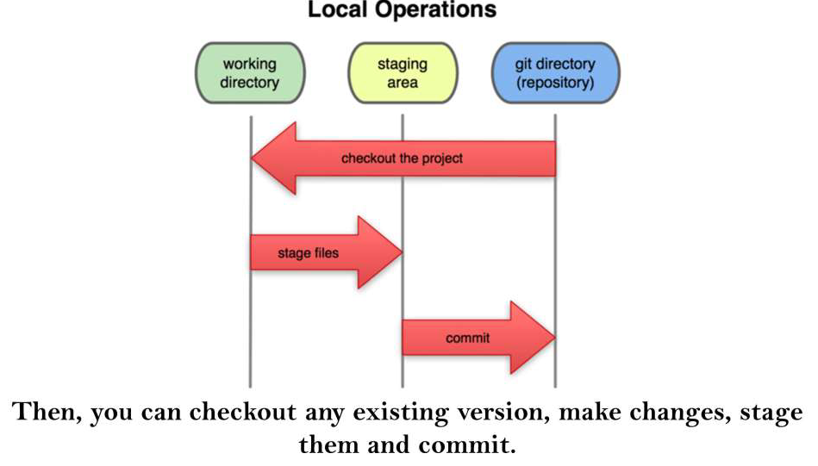
Git Work Flow 3 Stages

Slide 10
First Time Git Setup
Download the Git from git-scm/download → Windows/Linux and configure into the local system
Your Identity
git config --global user. name “Your Name”
git conﬂg --global user. email “example@mail.com”

Slide 11
command | description
git clone url [http or ssh] | Clone your Repo to your local syatem
git add files | adds file contents to the staging area
git commit | records a snapshot of the staging area
git status | view the status of your files in the working directory and staging area
git help [command] | get help info about a particular command
git push | push your new branches and data to a remote repository
others: init, reset, branch, checkout, merge, log, tag

Slide 12
Git commands
Command | Description
git clone url [http or ssh] | Clone your Repo to your local system
git add files | adds file contents to the staging area
git commit | records a snapshot of the staging area
git status | view the status of your files in the working directory and staging area
git help [command] | get help info about a particular command
git push | push your new branches and data to a remote repository
Git Branch Name | To Create Branch
Git Checkout Name | To Switch Branch
Git Log | Displaying the Commits
others: init, reset,merge,rebase,pull

Slide 13
Thank you

